Slide 1
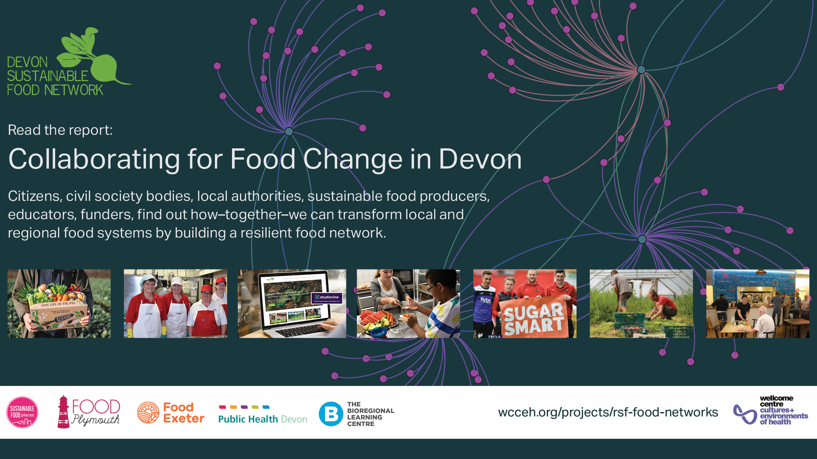
Dr. Rebecca Sandover

Slide 2
Place-based Sustainable Food Action
“Devon is a county with a wealth of food initiatives seeking to promote positive approaches to food security, health and wellbeing, food skills and cultures, access to food and local food supply chains. Currently these initiatives are largely operating individually and are focused on their local areas. There is now a great opportunity to harness this energy for Devon sustainable food and to scale up their work through effective county-wide coordination.” Sandover 2020

Slide 3
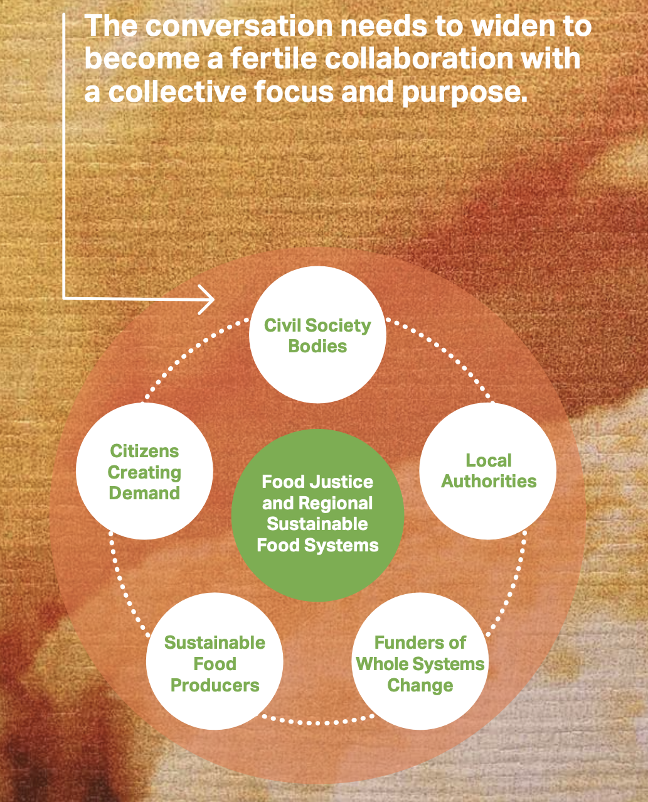
Developing an Integrated Regional Food System
Sandover 2020, diagram by Jane Brady

Slide 4
Challenges for progressing sustainable food in Devon
Differing Political structures with disparities in responsibilities
Differing geographies –rural areas with infrastructural challenges
Health and wealth disparities
Other challenges – Covid Recovery, Brexit, Cost of Living Crisis, Climate Change
Fig: Heart of the SW LEP Area Map

Slide 5
Frameworks for change - what we can learn from others
National and international frameworks acting on the need for sustainable food provides guidance for policy and programme change–Sustainable Food Places Network, Milan Urban Food Policy Pact, C40 Cities
National Food Strategy -recommendations

Slide 6
Summary
Place-based food initiatives = innovation at community and regional scales and building capacity in regional food systems
An integrated approach to policy making is needed to address the multi-issue, multi-sector challenges of food including food insecurity and access to food, the environment, education and health.
Partnership building from the ground up is essential for all voices to be heard
Collaboration and coproduction is needed for an inclusive approach to food systems change.

Slide 7
Thanks to:
R.Sandover@exeter.ac.uk
Twitter - @SandySom
Research Partners:
Food Exeter, Food Plymouth, The Bioregional Learning Centre, Public Health Devon, The Sustainable Food Places Network, The Cornwall Food Foundation, DCERG, The Devon Doughnut, The Devon Food Partnership, The Devon Food Insecurity Hub
Wider Networks
The Food Geographies Research Group (RGS-IBG) @Foodgeog
The Devon Food Partnership
The Environment and Sustainability Research Group + Exeter Geography colleagues

