Slide 1
Dorset CAN webinar 3 April 2025 Recycling in Dorset
Lisa Mounty - Service Development Manager

Slide 2
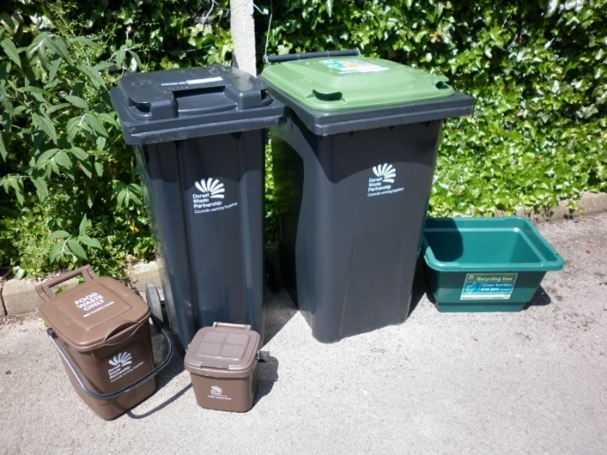
Key achievements – recycling performance
County wide ‘Recycle for Dorset’ kerbside service
Recycling and composting rate is 60.5% .
Number one unitary and disposal authority in the country.
Residual waste sent to landfill has been reduced to just 2%.
Ongoing annual savings through increased recycling and reduced waste disposal costs.
Continually improving the service – now accept foil and cartons in the recycling mix.

Slide 3
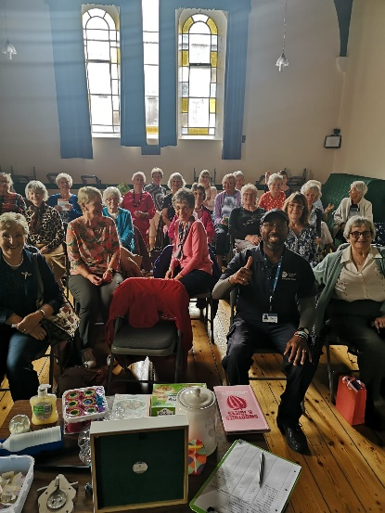
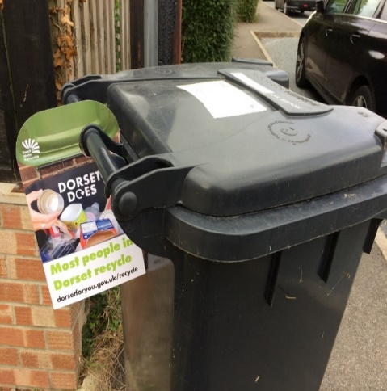
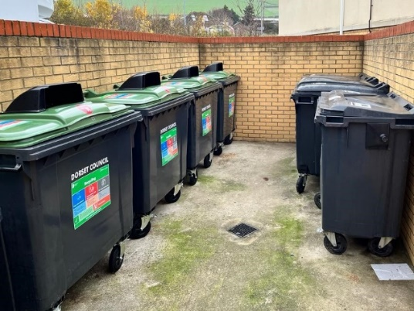
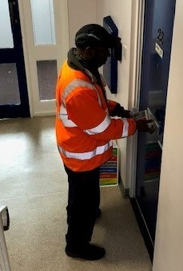
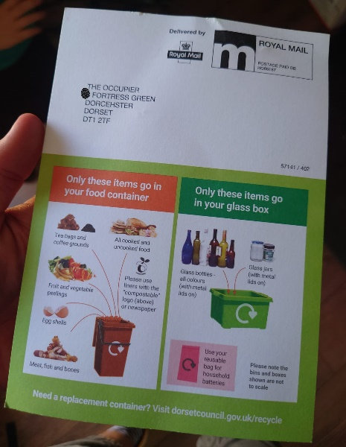
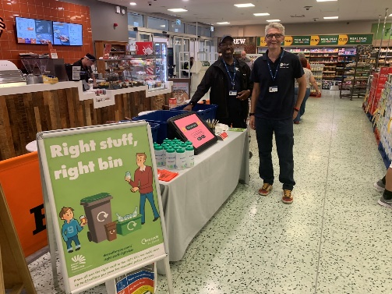
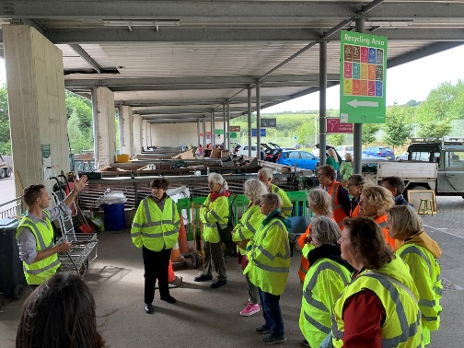
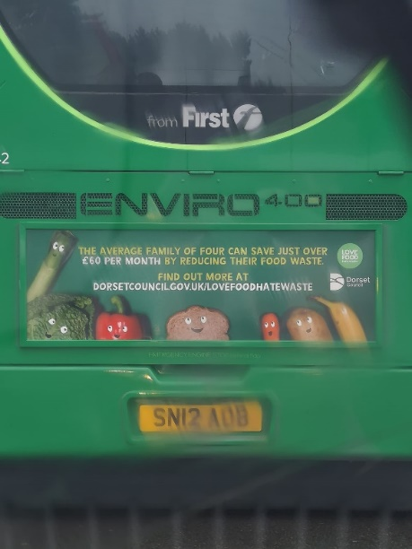
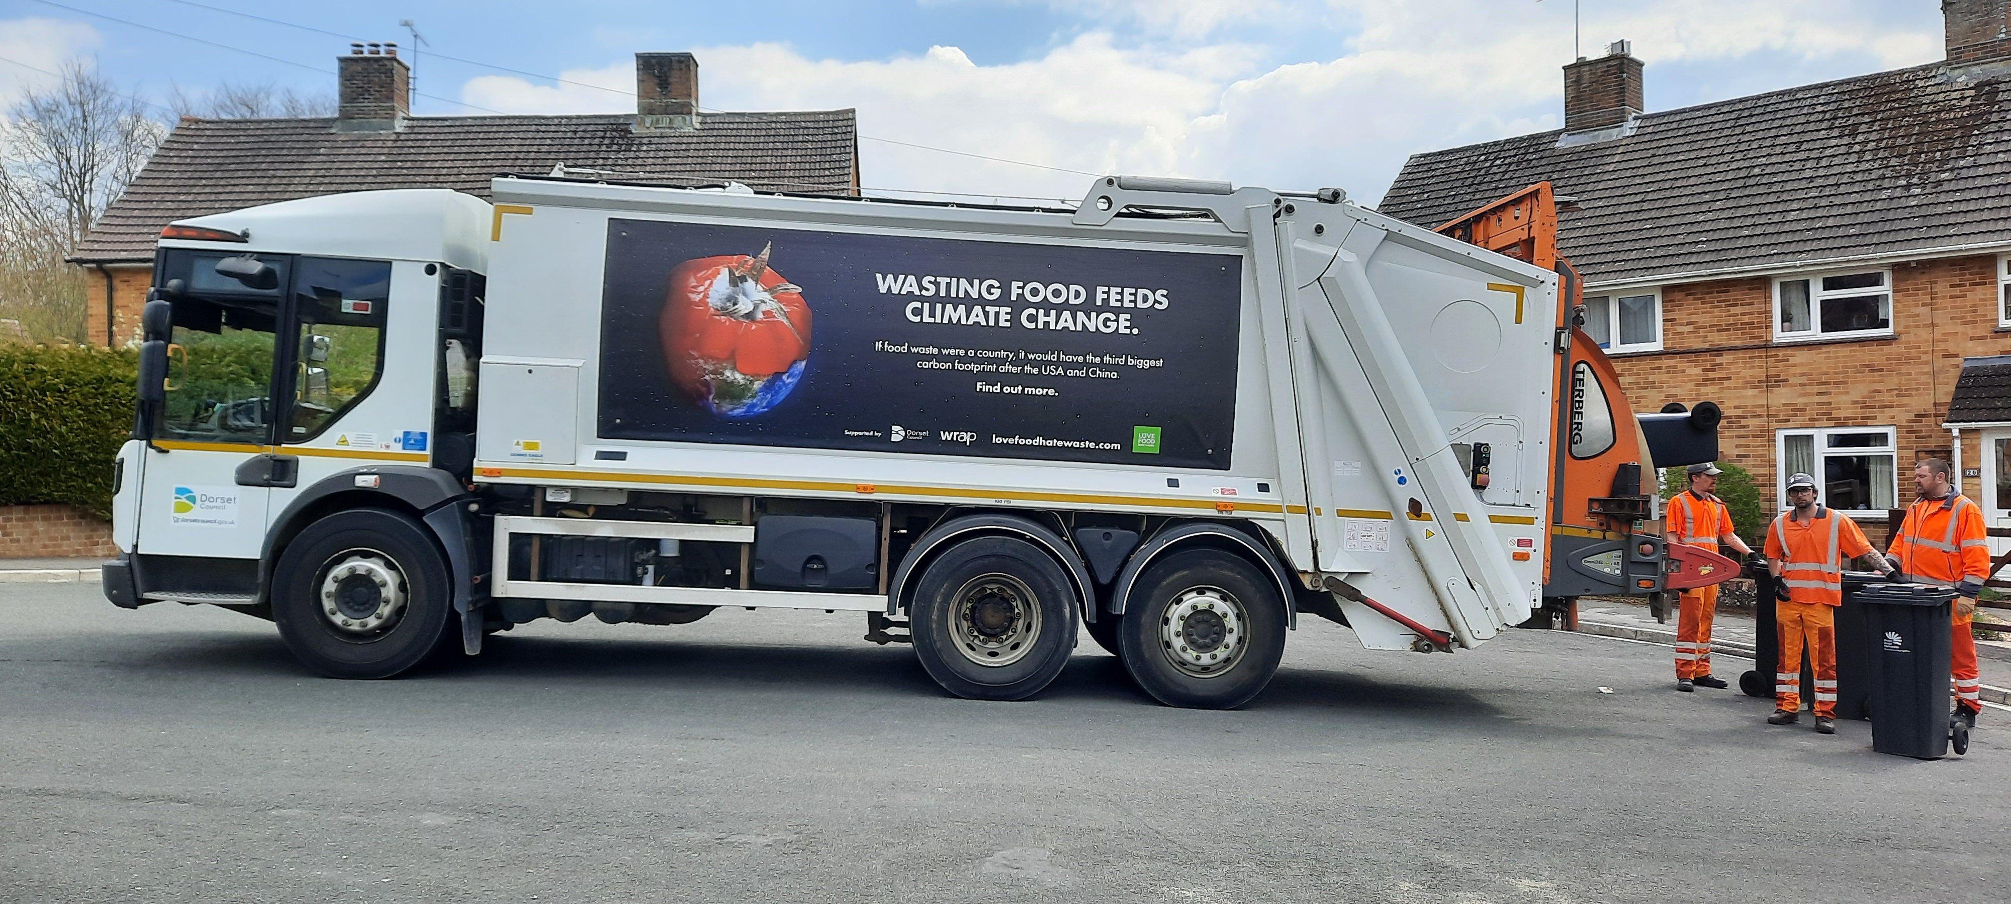
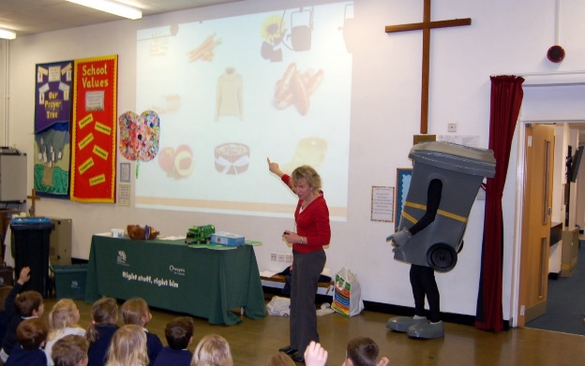
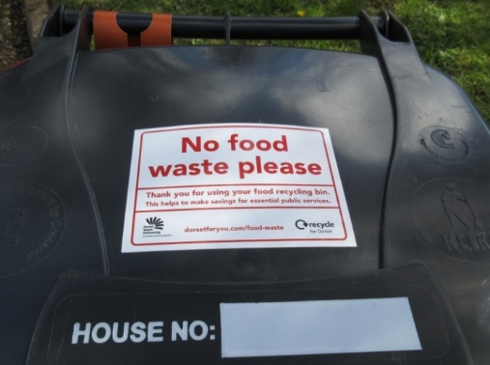
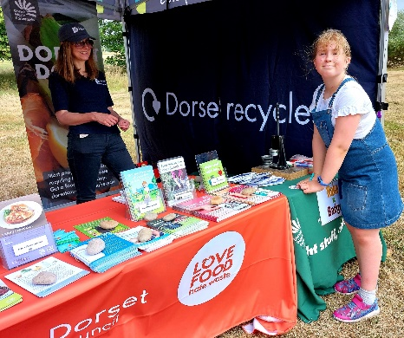
Regular communications on ‘reduce, reuse & recycle’
Social media, roadshows, local talks, fetes, agricultural shows, schools, site visits, library events, parish and town councils, website, livery on vehicles, direct mail on R4D (60k households/year), container messaging & R4D newsletter

Slide 4
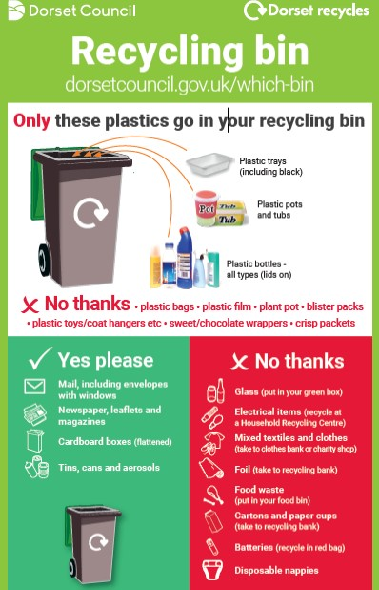
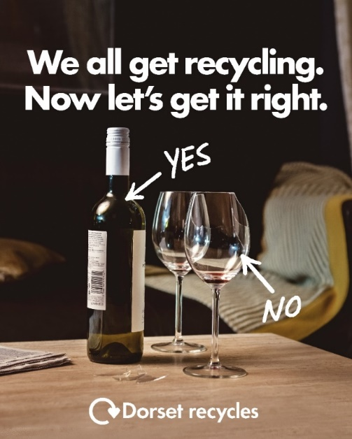
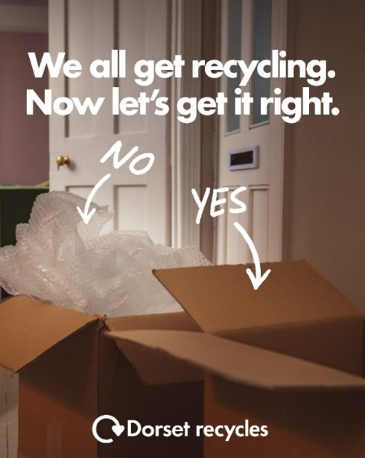
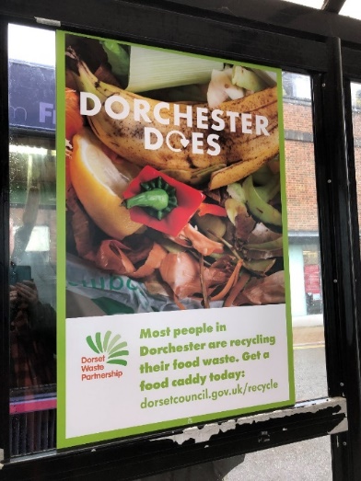
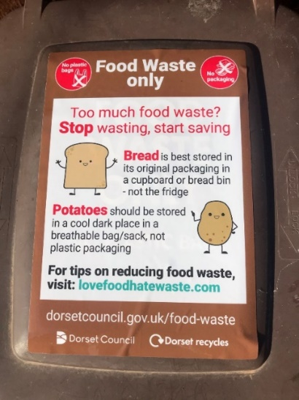
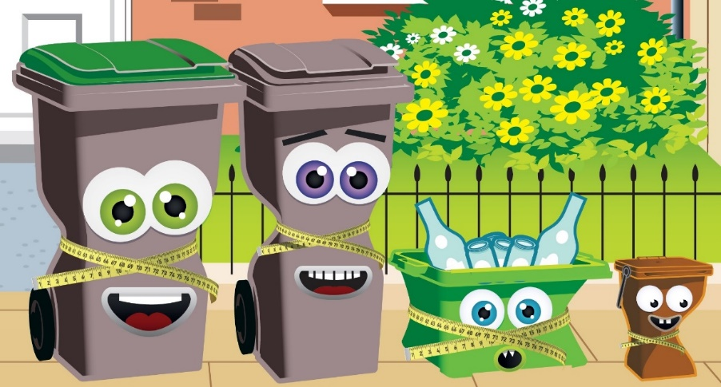
Targeted ‘recycling’ campaigns
‘Right Stuff, Right Bin’, Dorset Does, Slim your Bin,‘Yes/No’ contamination campaign

Slide 5
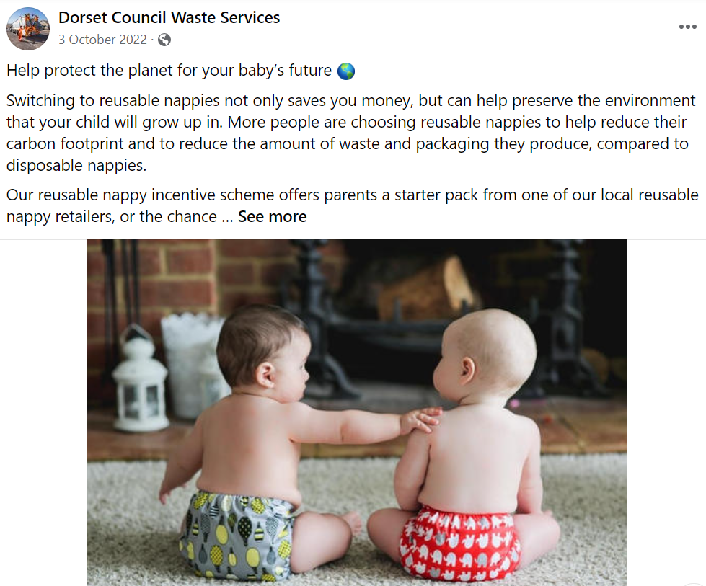
Campaigns on ‘waste reduction and reuse’
Reusable nappies, Love Food Hate Waste, home composting

Slide 6
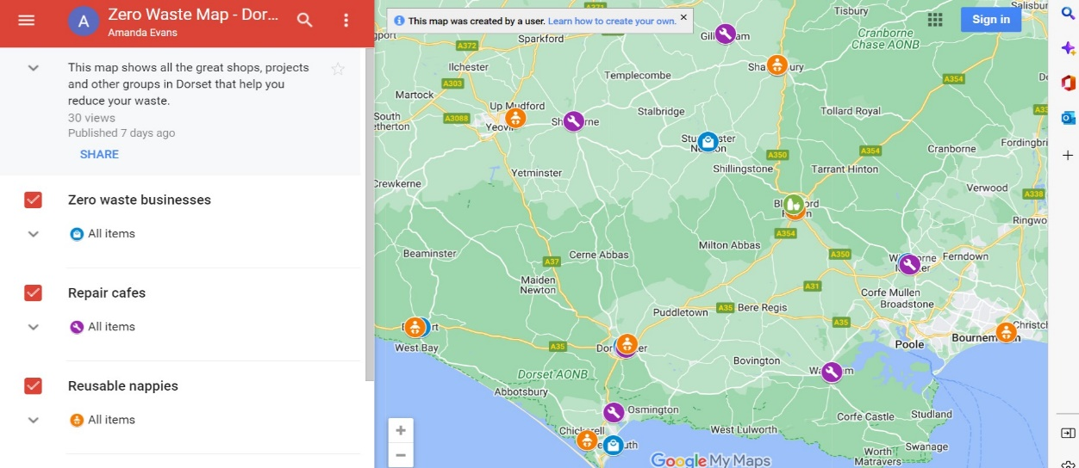
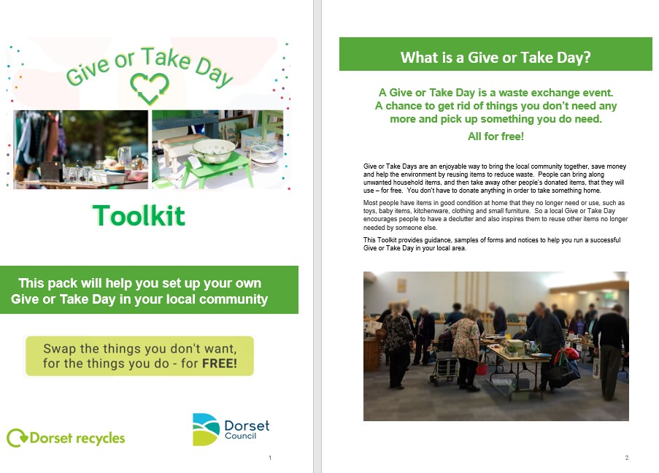
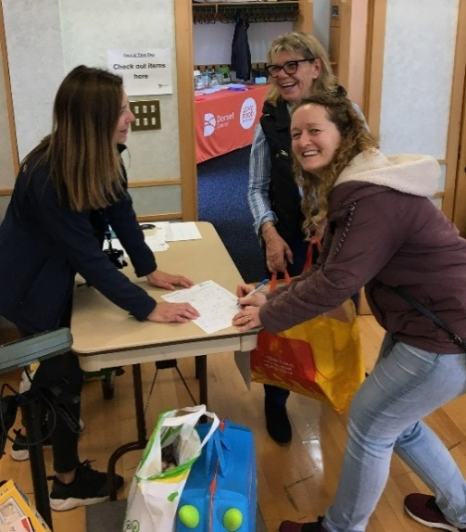
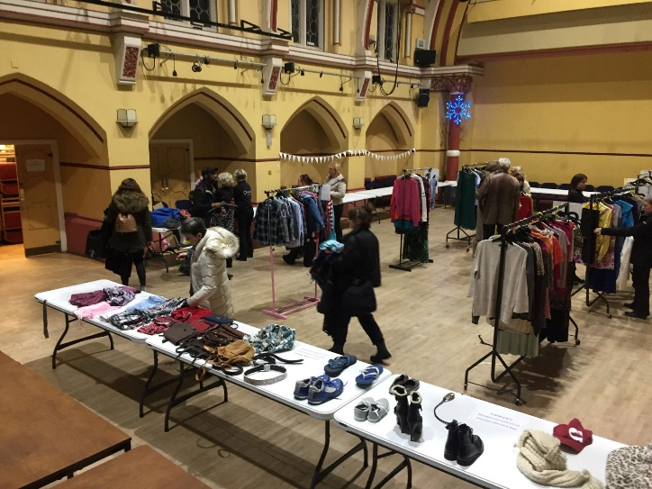
Campaigns on ‘waste reduction and reuse’
‘Give and take’ days, SWISH events, ‘zero waste map’, reusable period and incontinence products

Slide 7
Working with communities
Our existing work with the community:
Regular educational roadshows, library events, site visits, agricultural shows etc
Give & take days and swish events – provision of the toolkit for community groups wishing to organise one
Working with Litter Free Dorset to organise a series of electrical give & take days (to include 5 events)
Talks to community groups, schools, resident associations & business networks
Promotion of the zero-waste map – include details of repair cafes, community fridges, real nappy retailers, etc
Support litter picking groups by providing equipment and collecting/disposing of the waste after events
Currently preparing an engagement pack for town & parish councils (to include imagery, social media posts, etc)
Due to start a campaign whereby we do a monthly post on social media picking a different ‘difficult to recycle’ item each time, e.g. vapes, blister packs, batteries, etc
Appointing ‘community heroes’ to promote our ‘everyone is doing it’ message

Slide 8
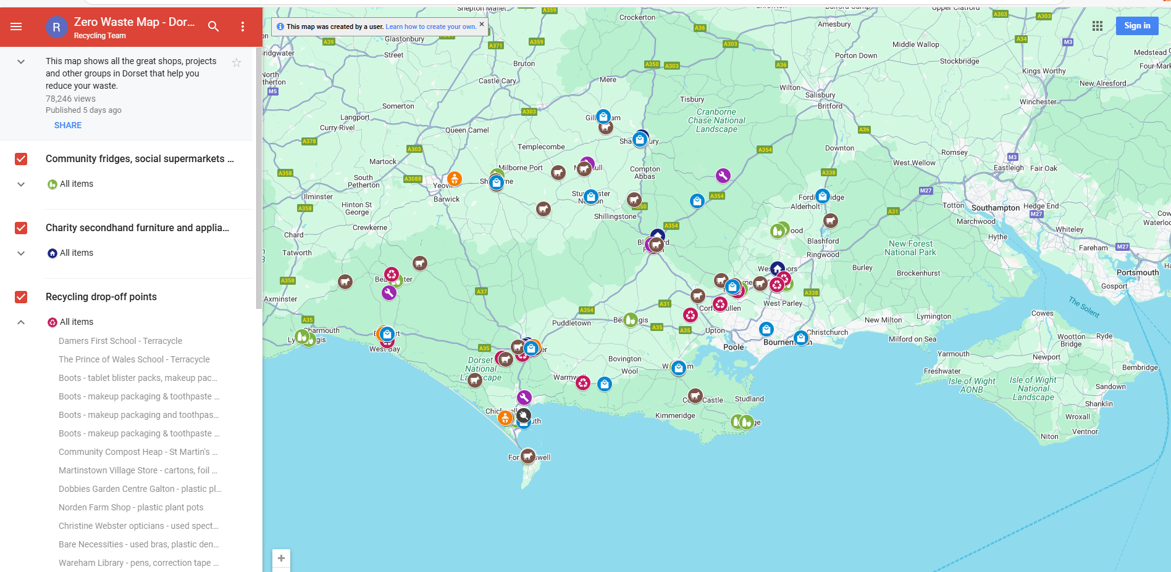
Zero waste map
Shows places that help residents reduce, reuse and recycle.
Find your nearest waste free shop, repair café, reusable nappy retailer, milk refill machine, library of things, community fridge, social supermarket, food bank, etc.
Includes lots of ‘difficult to recycle’ items
77,300 views since Jan 2023!
www.dorsetcouncil.gov.uk/-/dorset-zero-waste-map

Slide 9
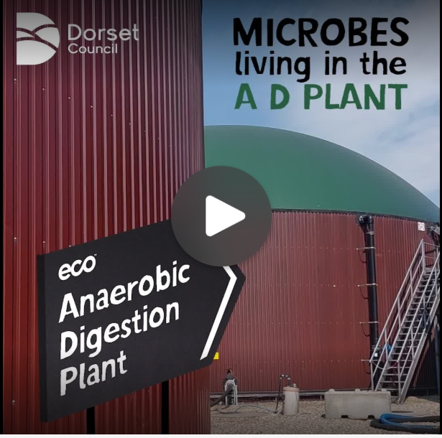
Final thought
We need the community to help spread the message and maximise the use of the current service:
32% of residual waste could have been recycled via the kerbside service
19% of residual waste is FOOD
Need everyone to put the “right stuff in the right bin”
This would save up to £1 million per year for essential public services
https://youtu.be/A9e0kVNQpKw

