Slide 1

Introduction to the Catchment Systems Thinking Cooperative project
Simon Browning
Monitoring Technical Lead at The Rivers Trust

Slide 2

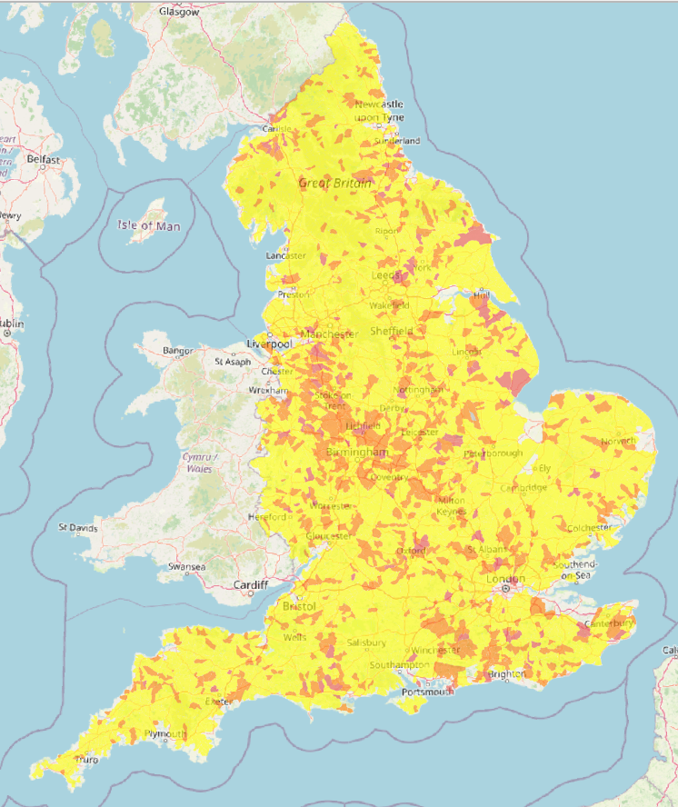
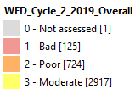

We have a problem…
Not a single waterbody in England is in good overall health
Year on year cuts to statutory monitoring
Gaps in environmental data
Limited collaboration in data collection / management
= fragmented decision making, inappropriate investments and further environmental declines
OVERALL STATUS (2019)

Slide 3
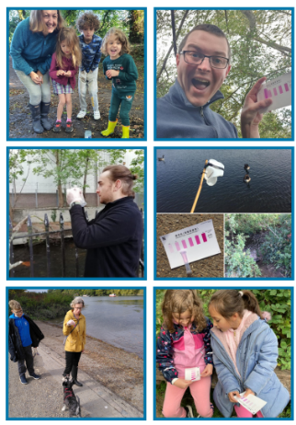
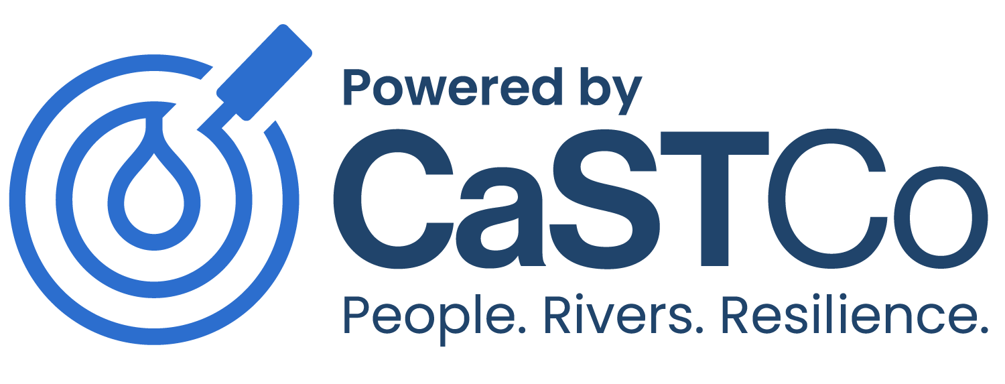
We have a problem…
We are seeing an explosion of enthusiasm in communities for collecting their own data to fill these gaps
But ‘Citizen Science’ – or volunteer monitoring - data is perceived by some to be less accurate or trustworthy than ‘official’ data
… which means it is not being used effectively to influence decisions about river and catchment management
The Catchment Systems Thinking Cooperative (CaSTCo) project was intended to address this

Slide 4
What is CaSTCo?
CaSTCo (Catchment Systems Thinking Cooperative) is a 3-year Ofwat innovation project involving 24 partners, which will test the establishment of…
… the Catchment Monitoring Cooperative (CMC)
A nationally standardised river monitoring framework to close the gap between people, data and decisions that affect rivers

Slide 5
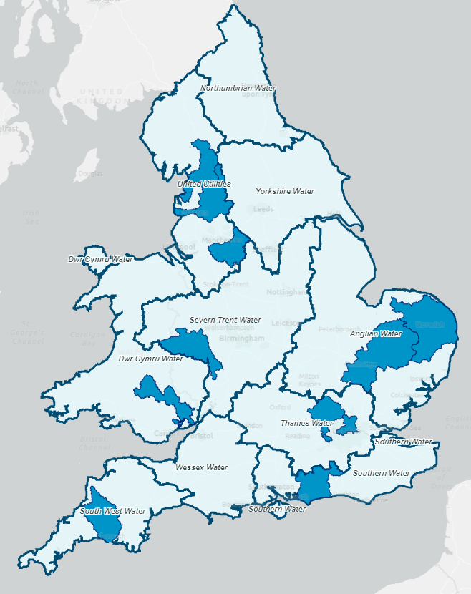
Key outputs include…
A Charter for Citizen Science – agree the rules for taking part
A list of accredited methods, with guidance and training
Collaborative monitoring plans in each Demo
An agreed approach for openly sharing results
Demonstrating how this works in 8+ ‘Demo catchments’
1
2
3
4
5
6
7
8

Slide 6

CaSTCo principles
1. Collaborative
Build a community aiming to improve river health
Break down barriers between sectors, including volunteers
Invest in collaborative plans and communicating outcomes
2. Impactful
Collect data for a purpose or outcome
Measure the results of new and existing approaches
Invest in projects that multiply impact
3. Open
Share data and ideas openly as a default
Provide easily accessed resources and lessons learned
Shine a spotlight on successes and how others can replicate them
4. Rigorous
Use appropriate best practices to collect and share data
Provide transparency on protocols to use results effectively
Institute checks and reviews that ensure high quality
5. Future-minded
Grow our community’s capacity to take care of rivers for the long term
Develop and use tools that support impact-driven outcomes
Embrace flexibility, adaptivity and innovation when appropriate
https://castco.org/about/#castco-principles

Slide 7
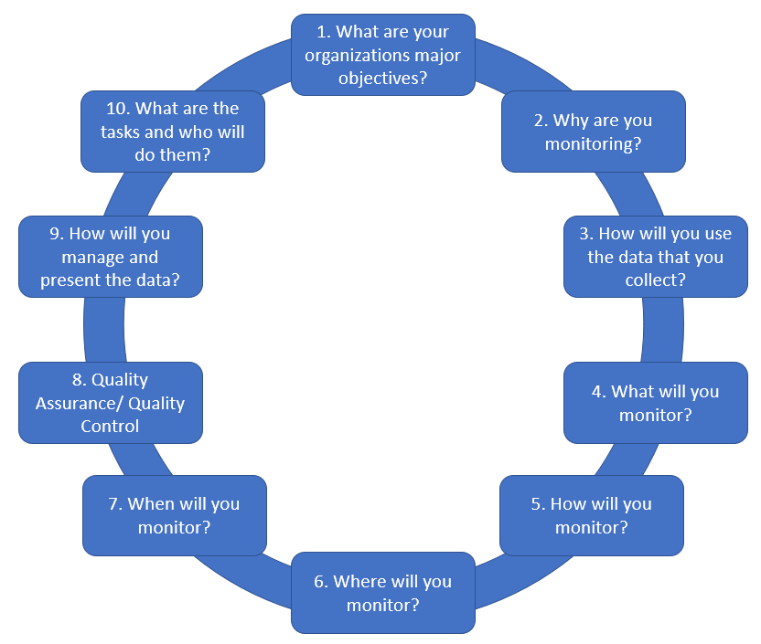

Monitoring planning
Why have a Collaborative Monitoring Plan?
It helps everyone focus on what they are trying to achieve
It helps to collate existing knowledge about your river or catchment
It provides a record of your objectives, methods and quality assurance measures…
… so that others can trust and use your data
https://castco.org/knowledge-categories/plan/
https://www.chesapeakemonitoringcoop.org/

Slide 8
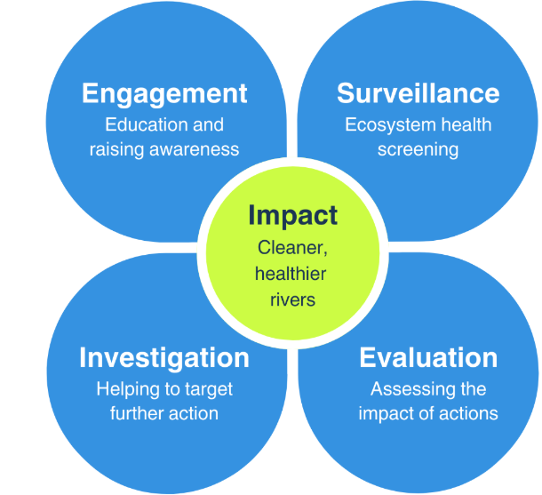
Defining your monitoring purpose
Each ‘type’ can be defined in terms of:
The overall objective
The scale of participation (10s – 1,000s)
The level of training / expertise required
The sophistication and robustness of the methods used
The target audience for the data and findings
The decisions that the results can influence
https://castco.org/knowledge-base/monitoring-purpose/

Slide 9
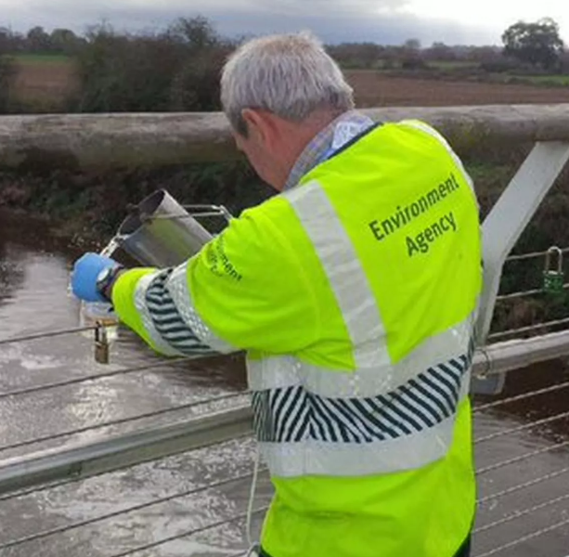
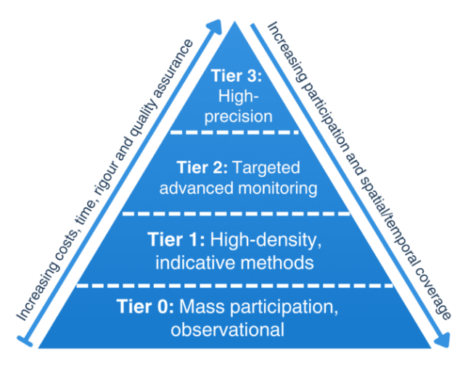
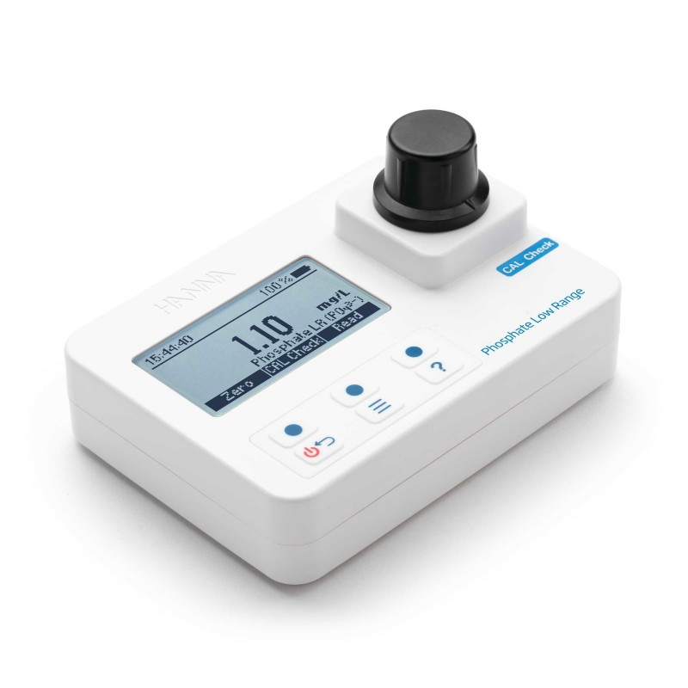

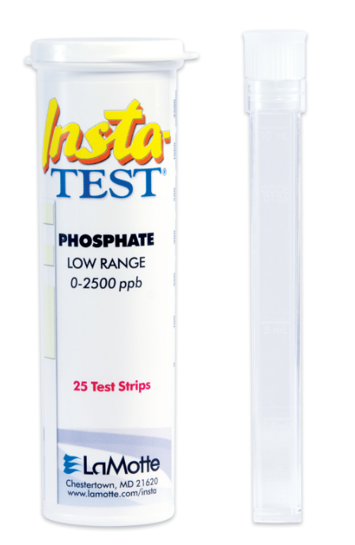
Method selection
Formal sampling and accredited laboratory analysis
c. £650 (+ £0.50 per test)
Superior optics and power management
c. £80 (+ £0.50 per test)
Fiddlier to use, precise result
Less than £1 / test
Easy to use, indicative result
https://castco.org/knowledge-base/methods-list/

Slide 10
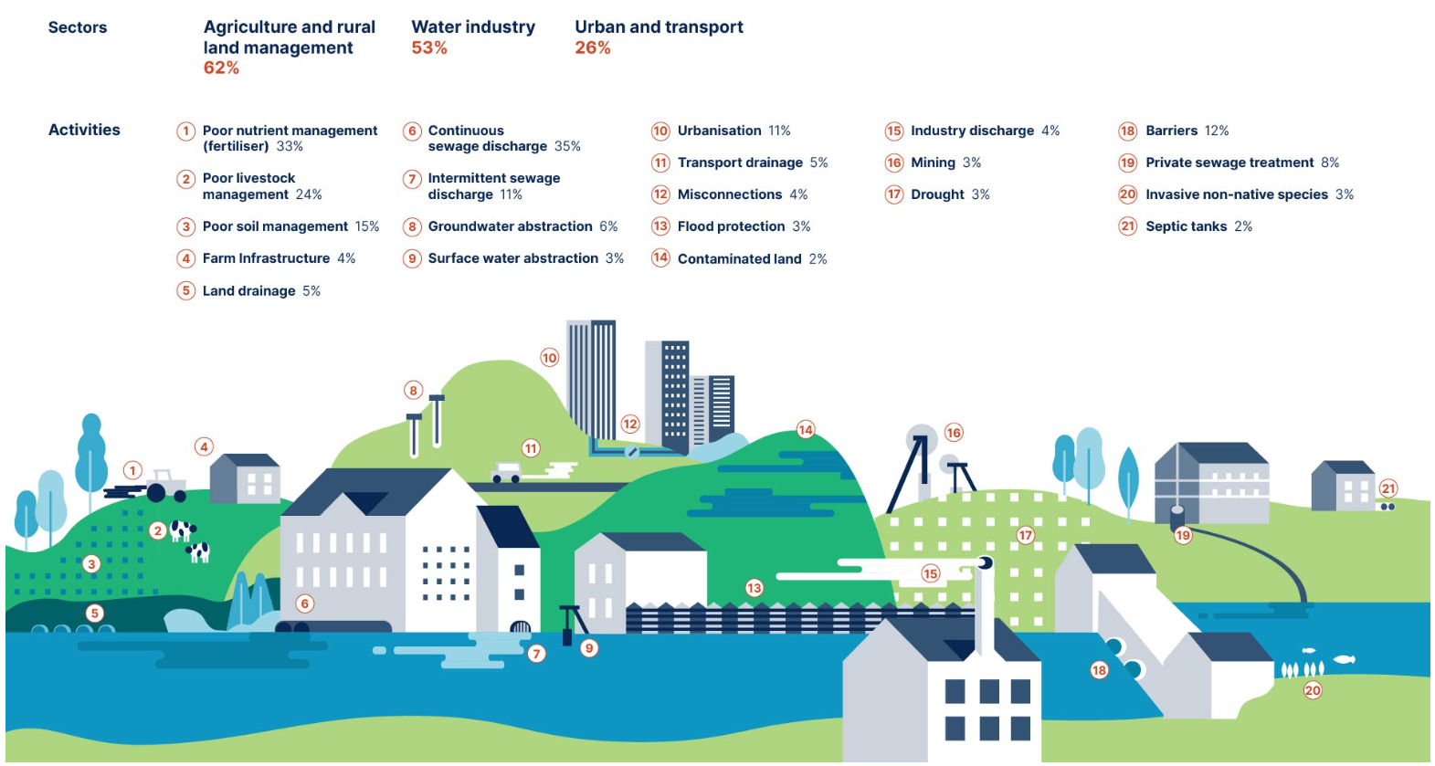
CaSTCo Mission
What change do we want to see?

Slide 11
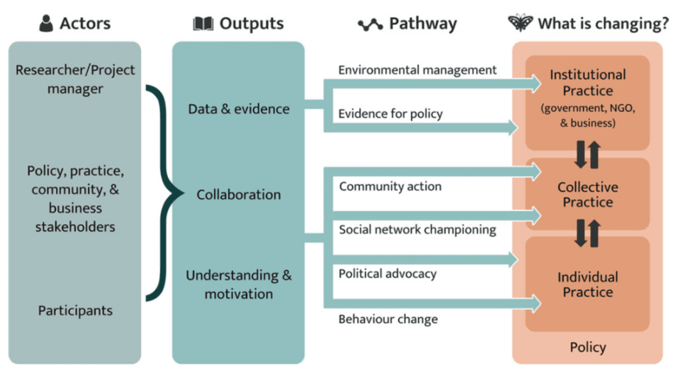

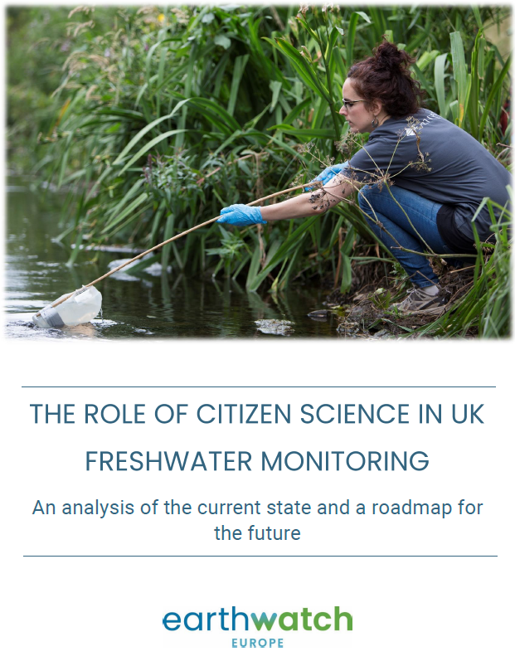
Making a difference – pathways to impact!
https://castco.org/knowledge-base/making-a-difference/

Slide 12

simon.browning@theriverstrust.org

