Slide 1
DORSET CAN – this evening's aims
To connect recycling groups to inform, inspire and enable
Scope for collaboration with Dorset Council and partners ?
a role for communities to support the council in providing hubs
potential for the expertise and infrastructure of the council to provide support for local initiatives.
Create community awareness of the principles of reduction and reuse

Slide 2
RECYCLING THE “EASY” TO RECYCLE ITEMS
Recycling centres:
Dorset has excellent facilities for many routinely recyclable items. But … There are limitations on access:
Time is money if you are self employed
Opening times – no out of work opening times except at the weekend
Elderly / non driving population
Limited access to building related trade
Kerbside / business recycling:
Can be tricky:
Space – for businesses and small / multi-occupancy homes.
Often holiday lets do not provide recycling bins.
Potential solutions:
Community group collections
Partnership with waste management services.

Slide 3
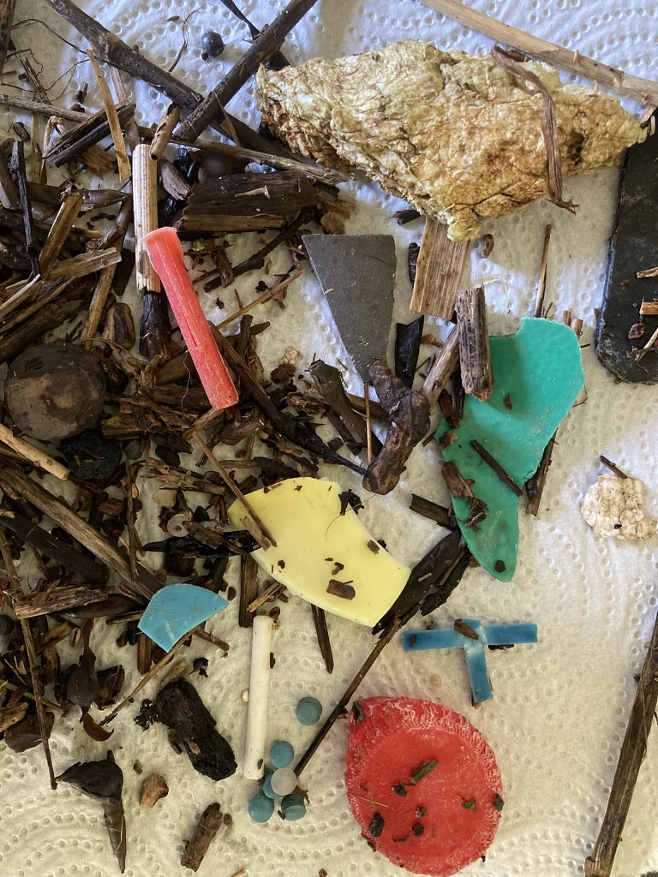
Charmouth as an example of difficult to recycle items
Tourists eat and drink A LOT !!
But tend to be respectful and use bins, within reason.
Plastic bottles, cans, broken / lost beach toys, polystyrene (surfboards), clothing
Sea related litter is a huge issue
Historical – from the Great Atlantic Garbage Patch?
Fishing related- crates, nylon, nets and rope
Global - biobeads/nurdles

Slide 4
Tourism consumption -Food packaging
Once emptied of contents food packaging is messy/contaminated so “Back to Base” messaging doesn’t work.
Onus on food vendor doesn't work. Purchased food is eaten elsewhere.
New business recycling rules - space and staff training
Some success with just recycling tins and plastic bottles
Contamination – with food residues / waste and dog poo !!
Ongoing liaison with DC on our issues.

Slide 5
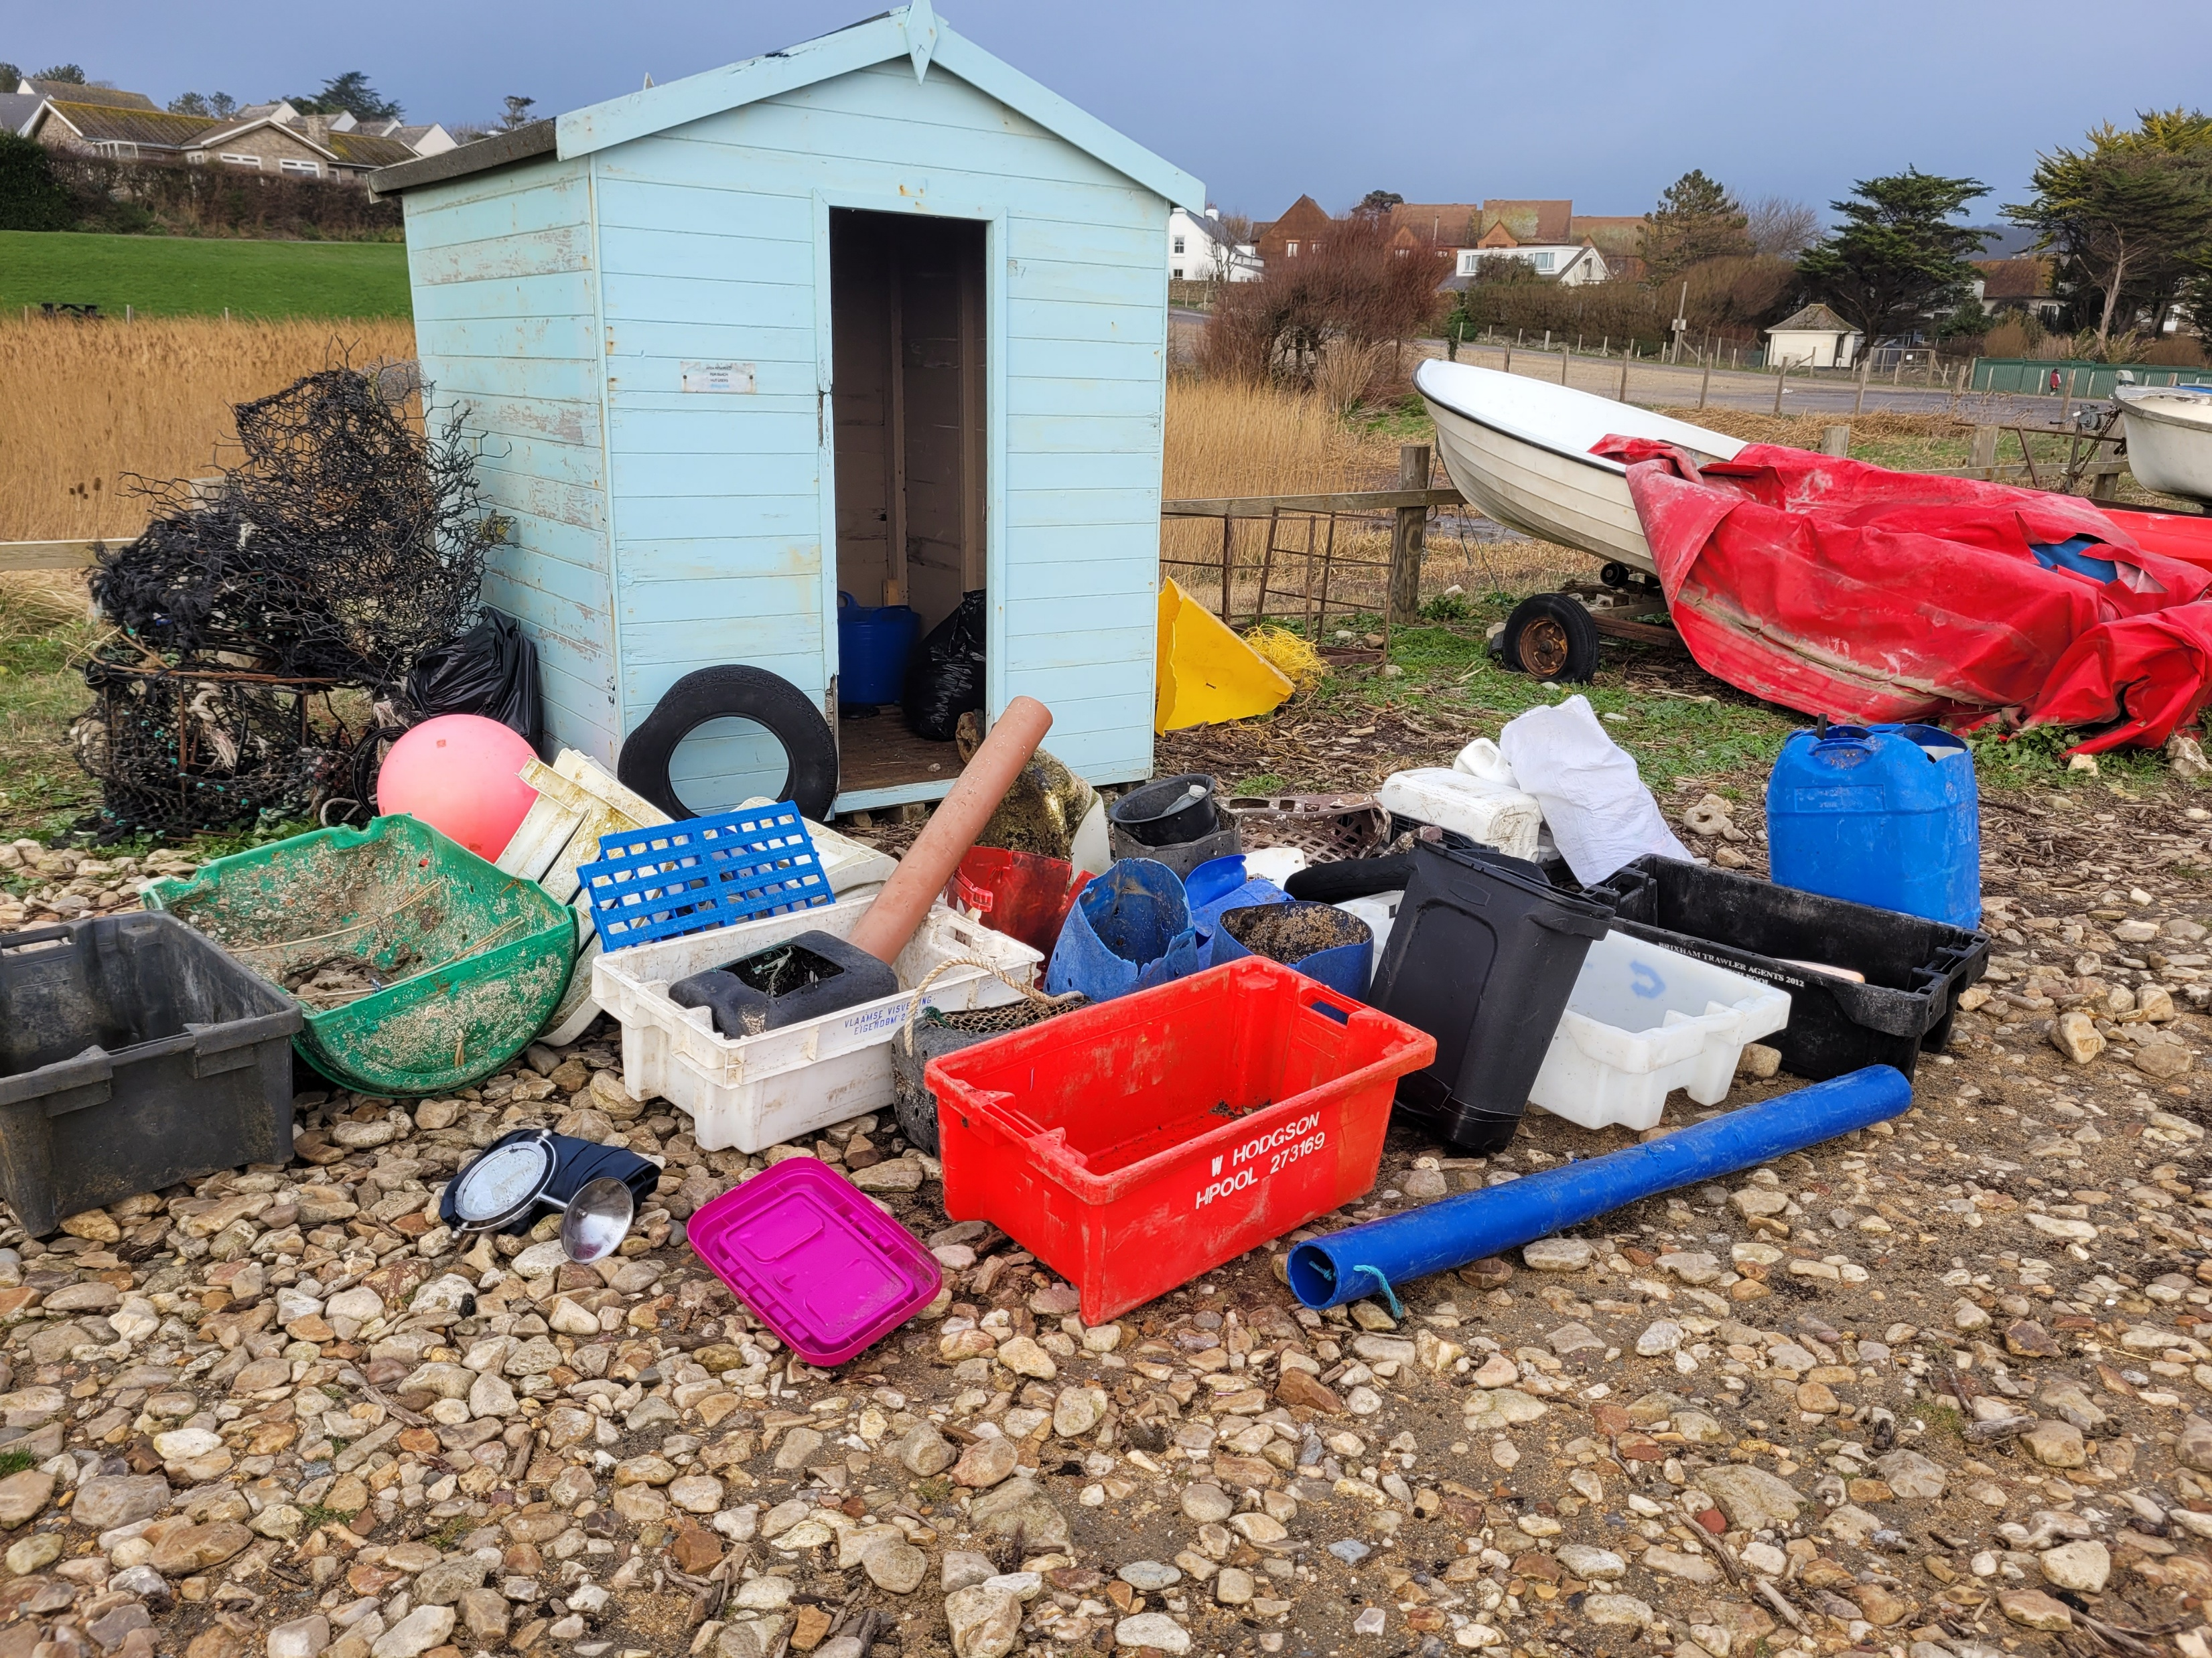
Marine Litter
Beach cleans - Heritage Coast centre, Parish Council staff and locals capture a lot of stuff
Dorset Council waste services cannot take this
In many cases once sorted it can be recycled.
An old beach hut has been set up as a hub
Different local and external groups help us
Problems – sorting is complex and can be hazardous – training and H&S
Waste is heavy and expensive to move.
Partnership solutions ?

Slide 6
